Slide 1


MeDi
Plan and apply for medical schemes easily

Slide 2

Figure 1: Mr Lum, a 65-year-old chicken rice stall vendor

Slide 3


One day, tragedy struck...
Figure 2: Illustration of tragedy striking
Notes:
Man suffered a heart attack and fell down, leg fracture, now its in a wheelchair

Slide 4
So expensive!
$$$$$
---------------------------
$$$$$
---------------------------
$$$$$
---------------------------
Figure 3: Mr Lum upon seeing his medical bills

Slide 5
However, he is able to get financial assistance
Being a senior citizen, he is eligible for many government schemes:
CHAS subsidies
Eldershield
Merdeka Generation Package
ElderFund
...

Slide 6
But applying for financial help is time-consuming
But all these schemes require paperwork to be done! Each scheme also has its unique benefits and some schemes are mutually exclusive with others.
In order to maximise the benefits he can reap, Mr Lum needs to painstakingly read through all the information on each scheme and decide which combination of schemes are best for him.
Notes:
Man is busy, coupled by the fact he is in a wheelchair limited mobility

Slide 7
Aiyo so many schemes!
Medisave
Medishield Life
Medishield
Elderfund
Eldershield
Careshield Life
Merdeka Package
CHAS
Figure 4: Mr Lum upon seeing the myriad of schemes and forms he has to go through

Slide 8
The Problem
Applying for financial assistance is long and tedious:
choosing the ideal plan (so many, how to choose?)
eligibility checks (bunch of lengthy forms)
making payment on time (some people might forget)
Can we simplify this process through the use of fintech?

Slide 9
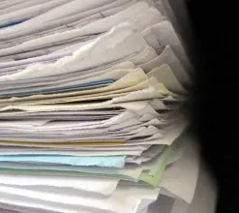



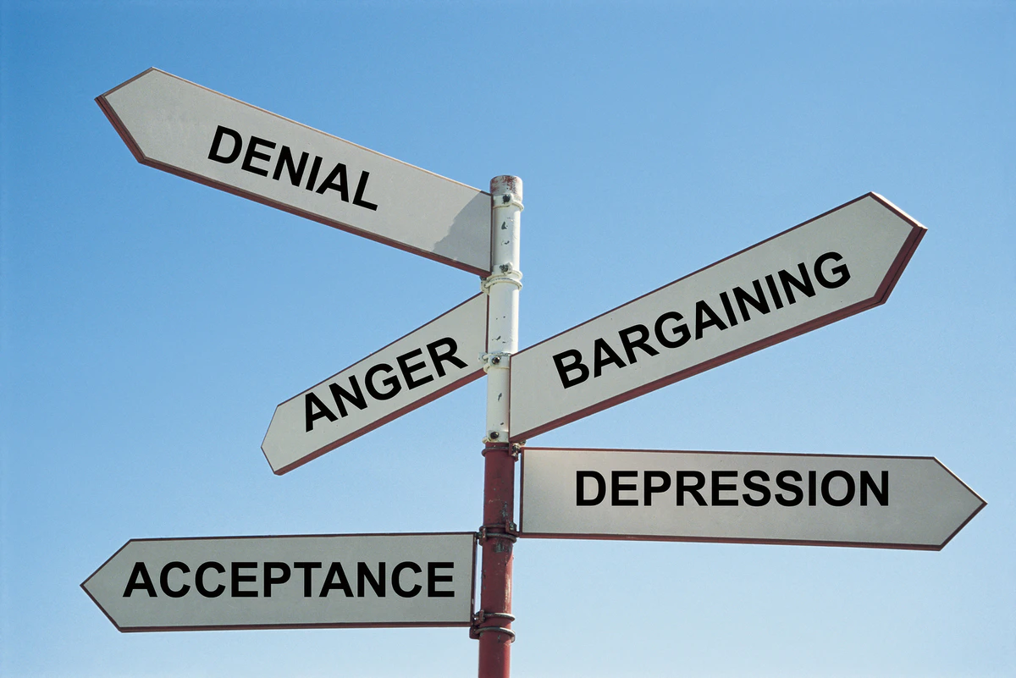
Introducing MeDi

Slide 10
Features
Intelligent Financial Assistance Recommendation
Aggregates personal/medical data and matches it with available schemes
Summarised report detailing the most suitable schemes, as well as the total cost breakdown for the user
Shows the inter-relationships between the scheme (which are mutually exclusive)*
One-click application for FA schemes and online payment
Reminder notifications to pay medical bills and take medicine (if any) on time

Slide 11
Client
Apply for scheme
Singpass
login
Scan medical records
Main dashboard
Pay medical bills
OCR
Return list of schemes
Amazon Textract
DBS Fund Transfer API
MyInfo API
Processed medical data
Singpass data
AWS Lambda
AWS EC2 Server

Slide 12
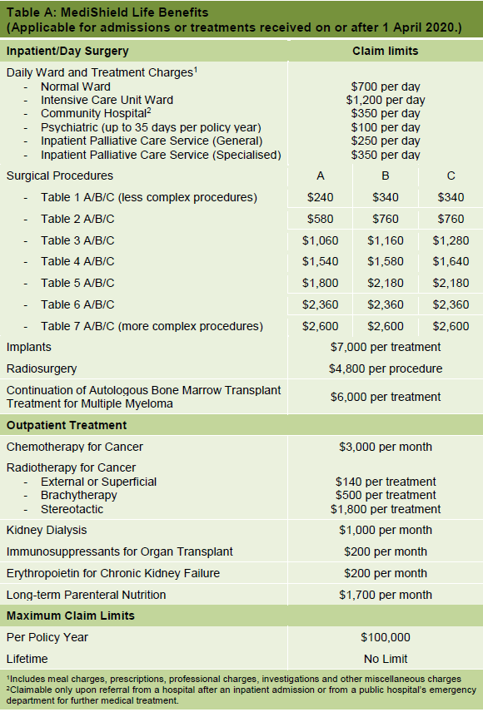
Data from Mr Lum’s case study
Coronary bypass surgery (type 6C surgery) (https://www.moh.gov.sg/cost-financing/fee-benchmarks-and-bill-amount-information/DetailsByHospital/SD812H--1--Ward---B2)
Average stay 7 days
Stayed at unsubsidised B1 ward at national heart center
Total cost: $34,204
No recomplication, no resurgery
16K operation fee
18K hospitalisation fee
Total claimable amount 2.3K + 700*7 = 7.2K
But part of claimable amount need to be paid (2000+200) = 2.2K
Out of pocket total = 34.2K - 7.2K + 2.2K = 29.2K

Slide 13

data
Medical data
Medisave Balance | $10,000
Birthday | 1st March 1959
Age | 60
Citizenship | Singaporean
... | ...
Type of Care | Acute Hospitalisation
One-Off Medical Cost | $34,200
Recurrent Monthly Medical Cost | $500
Medicine Prescribed | Aspirin, Isosorbide dinitrate ….
... | ...
Notes:
Medisave limits will pay 8.8K in total

Slide 14

Commercialisation
We could monetize our app through a software-as-a-service (SaaS) model.
To prove to consumers that the recommendations by the app are good, it will be offered as a free service. To generate some revenue from the free users, ads can be shown before the list of ideal financial assistance plans are generated.
However, ad-free usage and the other features (one-click payment and reminders for bills and medicine) will be locked unless they pay a subscription fee of $5 / month. The price is sufficiently affordable so that the service will be accessible to all who need assistance.

Slide 15
DEMO

Slide 16

The End

